Slide 1
Cracking The Next Growth Market: Africa
Sahiti Sri Upputuri

Slide 2

Problem Definition
Massive recent growth in African economy
High demand for commodities
Massive industry expansion
Pre existing agricultural economy
Leads to a platform for multinational corporations to enter the economy.

Slide 3
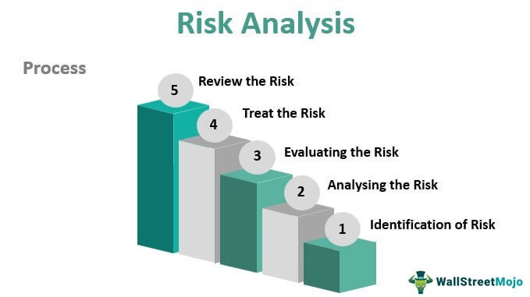
Risk Analysis
Risks:
Unstable governments in many countries
Leads to volatile economies
Weak overall infrastructure
Leads to unknown consumer markets
Advantages:
First move advantages
Can build brand loyalty and increase initial consumer base
Can set a baseline market price with regards to new items

Slide 4
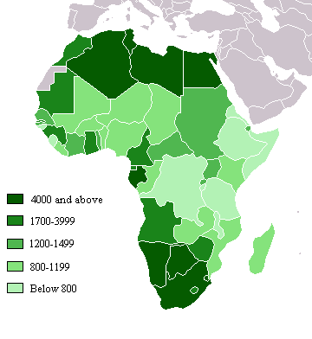
Market Overview
Diversified (Egypt, Morocco, South Africa)
Higher GDP/capita, higher discretionary income
Decent infrastructure
Oil Exporting (least diverse economy)
Rich resources but value tied to commodities
Transitional
Lower GDP per capita
Banking and telecom growth but no retail
Pretransitional
Many risks; $353 annual income

Slide 5

Our Two Market Entry Strategies
Retail Focus
Diversified Markets
Acquire regional players via acquisition
Foreign mid level managers for training
High-end non consumable goods
Transition Markets
No competition
Sell smaller quantities, credit lines, and payment plans

Slide 6
Attractive sectors in Africa
Opportunities in retailing, telecommunications and banking
Higher return on investment
Companies that enter Africa can shape industry sectors, segment markets
Economic and GDP growth, coupled with emerging shopping culture and boom in retail space
Shoprite had just one store outside its home country of South Africa in 1995, but has since become the continent's largest food retailer, opening 71 stores in other African nations
Transition economies- kenya, Ghana, Uganda, Senegal can offer strong consumer base for retailing

Slide 7
Growth and less risky sectors
Telecommunications
Investors are likely to achieve revenues and profits
316+ million subscribers - more than entire US population, since 2000
Data Services
10% increase in broadband penetration translates into additional GDP growth 0.5-1.5%
Applications like mobile health care
80% of health care issues resolved by mobile at a cost per capita 90% lower than that of traditional health care mobiles
Banking sector
50% of growth came from portfolio momentum, market’s natural increase
Financial sectors growing faster than GDP and its reforms largely enabled its growth
B/w 2000 and 2008, Kenya’s GDP grew 4.4% per annum; financial sector by 8.5% per annum
Also, Nigerian banking reforms- prompted a swift consolidation (from 89-25 banks b/w 2004 and 2006) that unlocked sectors potential.

Slide 8
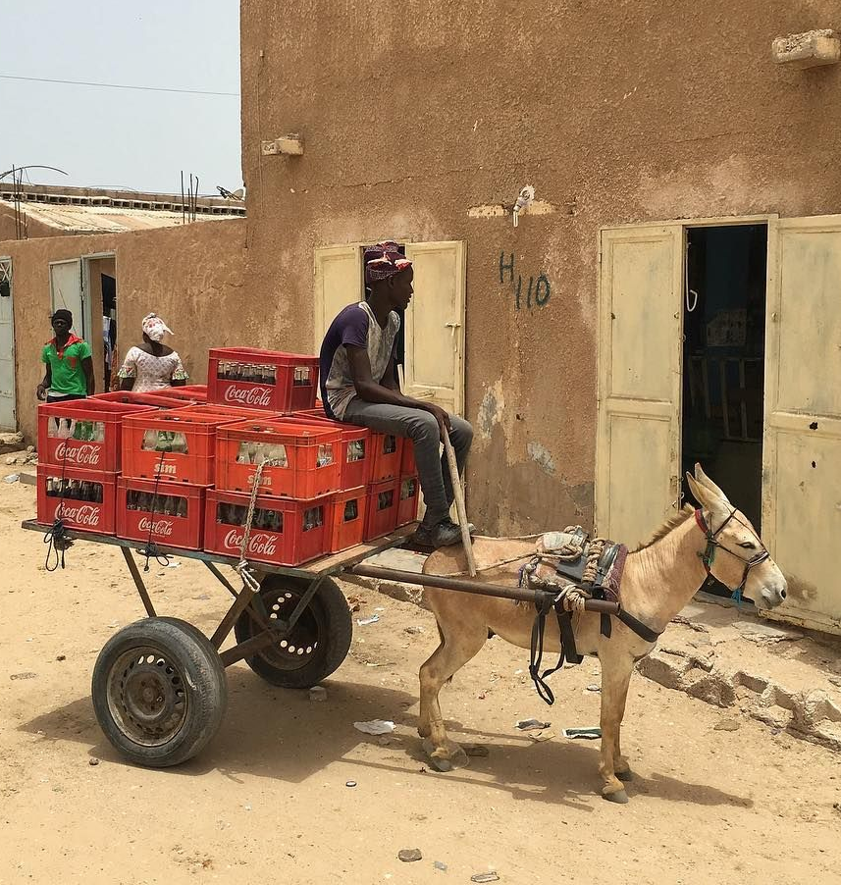
Minimizing Risk To Multinational Companies
Overcoming poor infrastructure and getting customers by getting to customers
Retail storefronts vs. informal vendors
Pursuing prospects across a range of markets can help reduce the overall risk faced by investors
Diversified economies and economies in transition
Investing in local infrastructure early is an ounce of prevention that is worth a pound of cure.
Vale’s operations in Guinea and Liberia
Notes:
Nouakchott, Mauritania. Aziz carrying coca cola crates with his donkey to go sale in shops Photo by @dcoreraphotography - Daouda Corera

